Slide 1
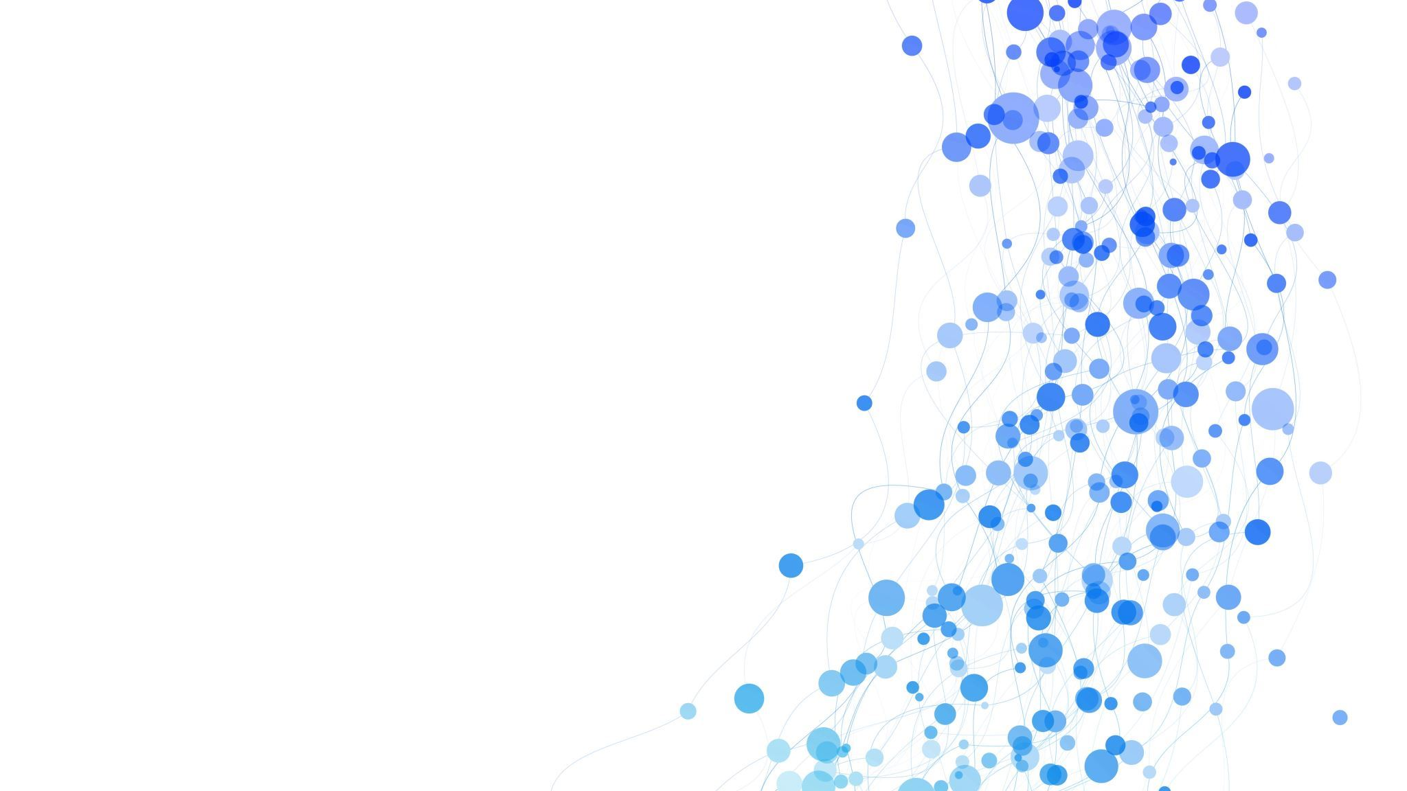



Large Language Models
Dr. Bishnu Sarker, Cameron Pykiet, and Jaylin Dyson
Meharry SACS

Slide 2
What we plan on covering
How popular LLMs work internally
Way to improve LLM model outcomes
Creating quick interactive web apps using Streamlit
Practical application of Streamlit apps.
Retrieval-Augmented Generation application with Ollama
Hugging face protein function prediction application
Sentiment analysis of text application

Slide 3
What are LLMs?
Everyone has heard of them by now, but formally, Large Language models are nothing more than a large scaled predictive model that utilizes efficient coding architectures to generate human-like text. They work through learning the patterns of language through vast datasets of text and using transformers to understand the context and relationships between words.
Their revolutionary success comes from attention mechanisms in a transformer that allows focus on relevant parts of the data that leads to understanding and generating accurate text.
They have shown promise in NLP, content generation, and research.
These models are very powerful, so it is important to know how are built so that users are better equipped for challenges and/or issues when they arise.

Slide 4
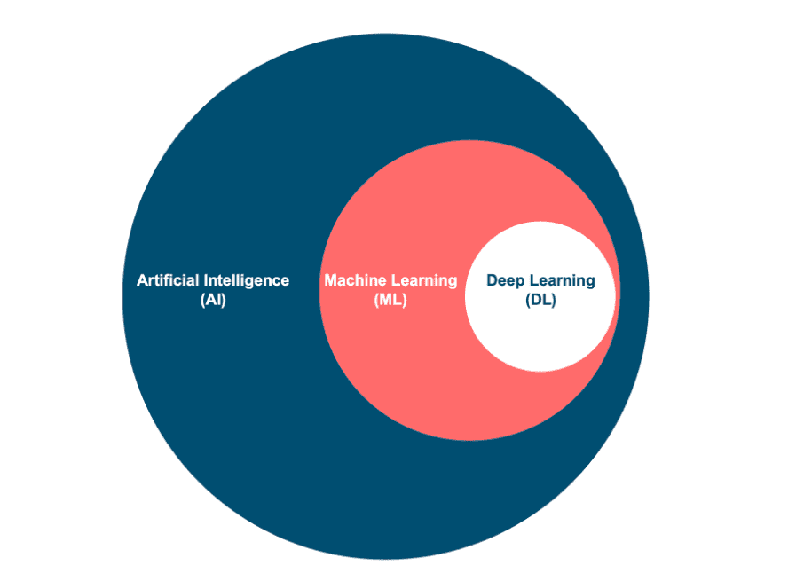

Slide 5
overview of GPT architecture
Decoder: GPT is based on the transformer model and uses only the decoder portion.
Causal Attention Masking: Ensures the model only considers preceding tokens to generate text step-by-step.
Scalability: Scales with more layers, larger embeddings, and larger datasets.
Unidirectional Context: Processes text left-to-right, focusing on sequential token generation.
Self-Attention: Tokens understand relationships by attending to each other.
Feedforward Layers: Add complexity and non-linearity to improve predictions.
This architecture has evolved through versions (GPT-1, GPT-2, GPT-3, GPT-4), with improvements in size, training data, and fine-tuning techniques for better performance and versatility

Slide 6
GPT Model
PROCESSING text OVERVIEW:
Because LLMs use text data, there are several natural language processing steps prior to vectorizations​
Cleaning Text​
Remove noise, special characters, whitespace, lowercasing (consistency)​
Normalization​
Handing contractions, spelling variations, stemming/lemmatization ​
Stop Words​
Weighing or removing common words (the, is, and)​
Tokenization (VOCABULARY)​
Splitting words into subwords with techniques such as BPE (byte pair encoding)​
Initial step between text representation and numerical representation
Architecture and Workflow of a GPT Model
Preprocessing The Text
Transformer Blocks
Language Model Head
Raw Text Input
Word Embeddings
Contextual Embeddings
Predicted Text
Notes:
Mention Relational versus absolute for the positional embeddings
- Be sure to make note to the crowd that this is how we are initially creating our embeddings and that they are randomized at this point.
- Make note that the raw text is meant to represent large amounts of text such as books, web scraping, but the example only mentions a sentence.
-state how the ids and token embeddings are used to translate back to the word, which will be used later for word prediction.

Slide 7
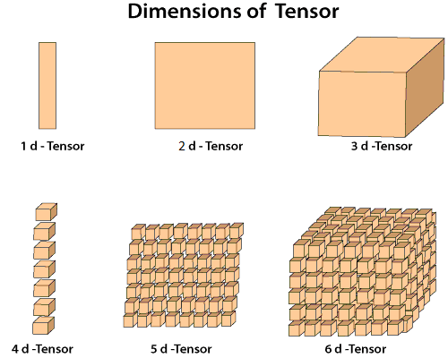
vectorization
Architecture and Workflow of a GPT Model
Preprocessing The Text
Transformer Blocks
Language Model Head
Raw Text Input
Word Embeddings
Contextual Embeddings
Predicted Text
PROCESSING text OVERVIEW:
The
King
,
John
Following tokenization, tokens get vectorized into tensors to allow the model to process the tokens.
These representations are also known as embeddings
These embeddings are stored in tensors (multidimensional arrays)
Embedding dimension determines the size of each token vector.
This effects overall parameter count
Obviously, larger dimensions capture more info, but it comes at a larger computational cost

Slide 8


Architecture and Workflow of a GPT Model
Preprocessing The Text
Transformer Blocks
Language Model Head
Raw Text Input
Word Embeddings
Contextual Embeddings
Predicted Text
PROCESSING text OVERVIEW:
The
King
,
John
Token embeddings
Positional embeddings
Token ids
Final word embeddings
Tokens:
T.E.[0.1, 0.3, 0.7, 0.9]
The
000
T.E. + P.E. = Embedding
RAW TEXT:
P.E.[0.01, 0.02, 0.03, 0.04]
"The king, John"
T.E.[0.2, 0.5, 0.8, 1.0]
T.E. + P.E. = Embedding
King
001
P.E [0.05, 0.06, 0.07, 0.08]
,
T.E. [0.0, 0.4, 0.6, 0.2]
002
T.E. + P.E. = Embedding
P.E. [0.09, 0.10, 0.11, 0.12]
John
003
T.E. [0.3, 0.7, 0.9, 0.4]
T.E. + P.E. = Embedding
P.E. [0.13, 0.14, 0.15, 0.16]
Notes:
Mention Relational versus absolute for the positional embeddings
- Be sure to make note to the crowd that this is how we are initially creating our embeddings and that they are randomized at this point.
- Make note that the raw text is meant to represent large amounts of text such as books, web scraping, but the example only mentions a sentence.
-state how the ids and token embeddings are used to translate back to the word, which will be used later for word prediction.

Slide 9
Architecture and Workflow of a GPT Model
Preprocessing The Text
Transformer Blocks
Language Model Head
Raw Text Input
Word Embeddings
Contextual Embeddings
Predicted Text
PROCESSING text OVERVIEW:
There are different ways and methods to achieve tokenization and embedding.
Chat GPT uses Byte Pair Encoding (BPE)
Category | Methods | Tools/Examples
Word-level | Splits into full words | NLTK, SpaCy, Gensim
Subwords | Splits into subwords | BPE (OpenAI GPT), WordPiece (BERT), SentencePiece (T5)
Character-Level | Splits into individual chars | Custom Python, Byte-Level (GPT-2/3)
Sentence-Level | Splits into sentences | NLTK, SpaCy, Hugging Face Transformers
Hybrid | Combines multiple levels | SentencePiece, Custom Pipelines
Specialized | Domain-specific tokens | Galactica (Science), Codex (Code)

Slide 10

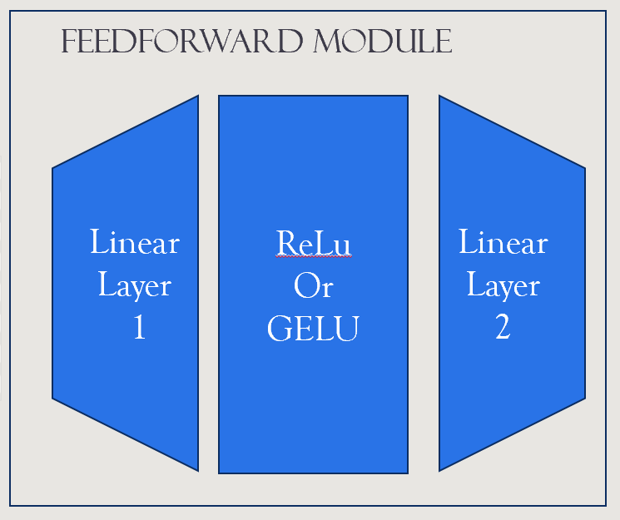
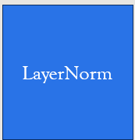
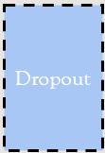
Architecture and Workflow of a GPT Model
Preprocessing The Text
Transformer Blocks
Language Model Head
Raw Text Input
Word Embeddings
Contextual Embeddings
Predicted Text
Transformer Block OVERVIEW:
Dimensionality
LayerNorm
Dropout
Notes:
ReLU (Rectified Linear Unit)
GELU (Gaussian Error Linear Unit) with is used in CHAT GPT
Mention that newer models are using RMSNorm in place of the traditional Layer normalization

Slide 11
LayerNorm
Layer normalization takes the outputs (or activations) of a layer and:
Finds the average (mean)
Calculates how far the numbers are spread out (variance)
Adjust the numbers to fit into a standard range (mean = 0, variance = 1). This makes data uniform.
Layer normalization includes two extra ingredients:
Scale (γ): This allows the network to adjust how "big" the numbers should be after normalization.
Shift (β): This lets the network tweak where the numbers are centered.
Why is Layer Normalization Important?
Helps the network learn faster: When the numbers are more consistent, the network doesn’t get confused by very big or very small values. It can focus on learning patterns in the data instead of struggling with the math.
Improves stability: Big or small numbers can make the training process unstable (like burning or undercooking cookies). Layer normalization keeps things under control.
Works with any batch size: Unlike some other methods (like batch normalization), this doesn’t depend on how many examples you feed into the network at once. So it’s great when you’re working with small batches of data or even single inputs.
Notes:
I have reviewed the information button, and everything is clear and concise, accurately describing the report's content.

Slide 12
Why Attention mechanisms
Pre-LLM architectures were not good at formulating context which is essential for things such as translating due to grammatical differences.
Recurrent Neural Networks (RNNs) were a popular choice as they took input text, fed it into an encoder which processes sequentially. Using hidden layers, it tries to capture meaning of the input. This was bad as it couldn't access prior hidden states.
RNNs were effective for short text, but lost meaning with longer text

Slide 13
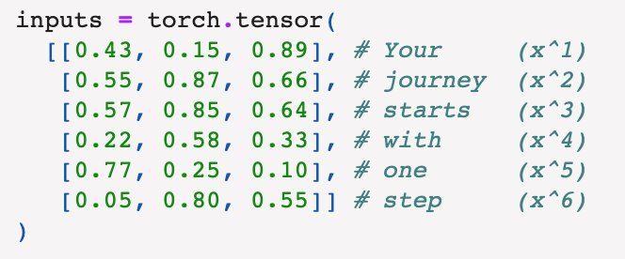
Attention mechanics
Self-attention mechanisms allowed for each position in an input sequence to consider the relevancy of all other positions in the same sequence. This is one of the key components of the transformer architecture.
The output for attention mechanisms is a context vector for each word which are constructed through a series of mathematical processes with the embeddings.

Slide 14
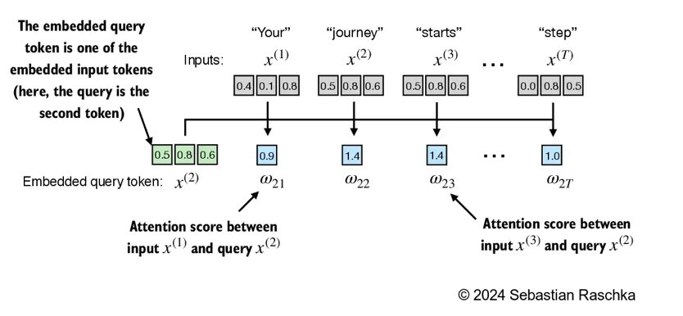
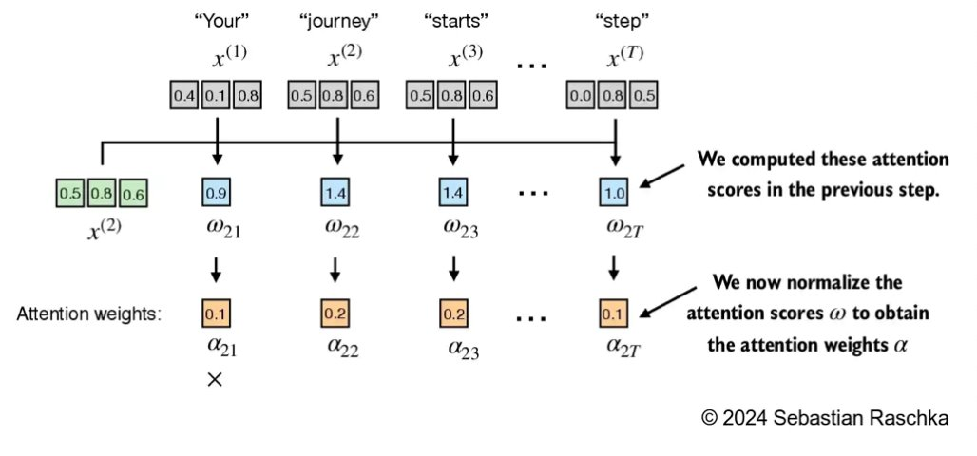
Attention Mechanisms
Attention Score
Attention Weights
Attention scores are calculated by performing the 'dot product' with the embeddings of each token with every other token in the sequence.
Weights calculated by normalizing the scores.
Score / sum of all scores

Slide 15
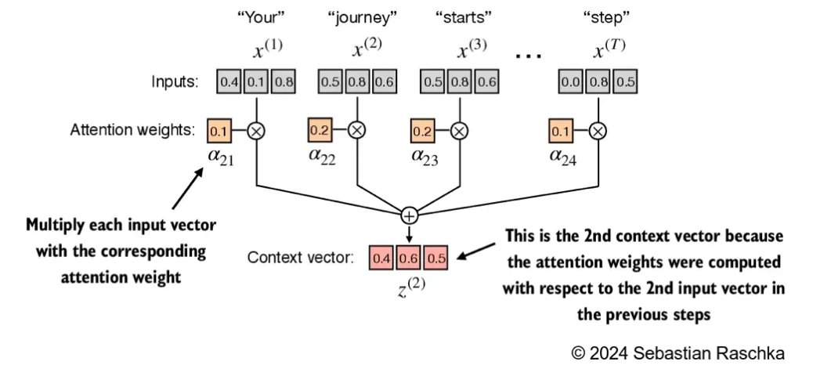
Attention Mechanisms
The attention weights are used to calculate the context vector by scaling the input token embeddings by their respective weights and then summing them to result in a context vector.

Slide 16
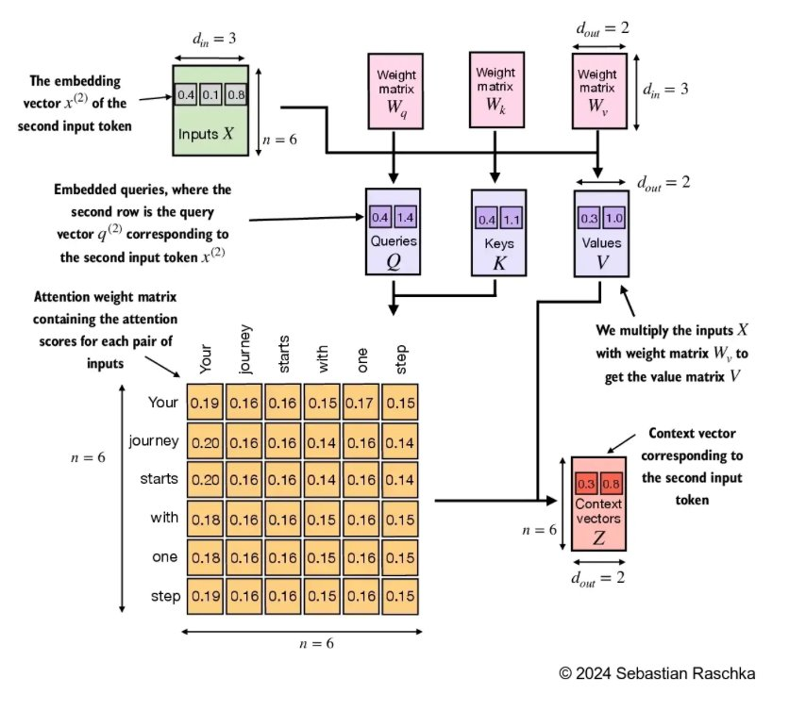
Attention Mechanisms
Trainable weights are implemented to help further the understanding of words within context.
These weights include Query weights, Key weights, and Value Weights which change through training.
There are several different methods for calculating weights that allow the models to be more stable.

Slide 17
Query, key, and value weights
Query weights - 'What am I looking for?’
Represents the current tokens’s ‘question’
Key weights - 'How relevant am I?’
Represents an address for each token to compare to query
Value weights - 'What information do I carry?’
Contains the actual content of a token that is passed to the next layer based on attention scores

Slide 18
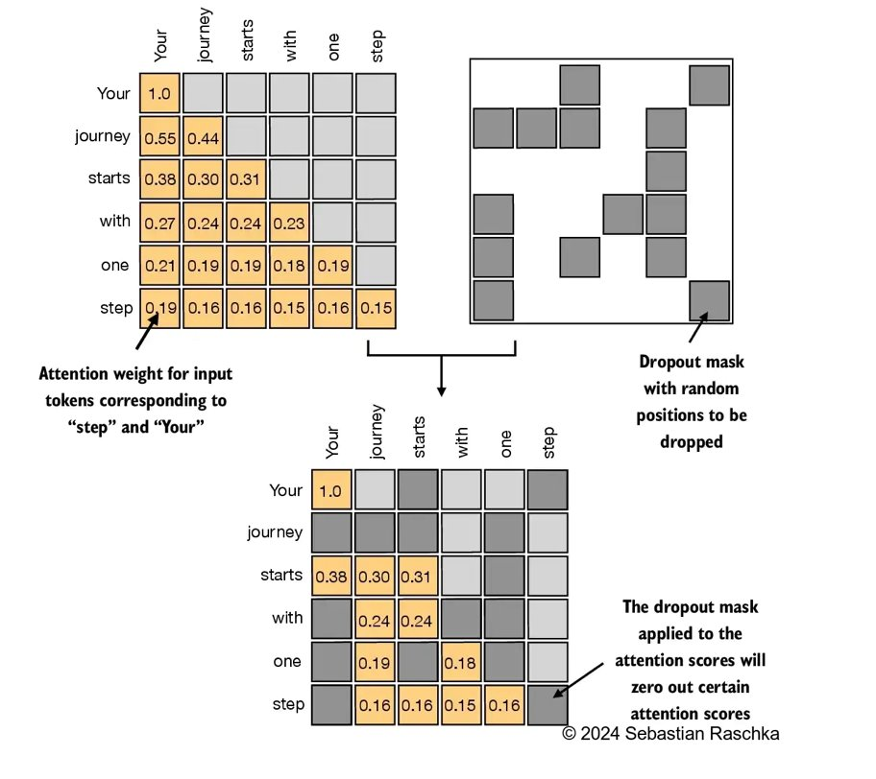
Attention mechanisms
Previously, all words in a sequence were being taken into account. However, in actual language we only pay attention to what comes before. Thus, Casual/Masked Attention is used to zero out all following tokens when calcuating context within the sequence.
Dropouts also occur by randomly ignoring selected layers to help avoid overfitting. Though the remaining weights are doubled as a result

Slide 19
Dropout
Dropout randomly "drops out" (sets to zero) certain neurons in a layer during training. It prevents overfitting by ensuring the model does not become overly dependent on specific neurons.
How it Works:
For each training iteration (or mini-batch), a dropout mask is applied.
Neuron outputs are set to zero with a probability p, the dropout rate.
Remaining activations are renormalized to maintain the overall scale of the layer’s outputs.
Dropout is disabled during inference, allowing the full network to be used.

Slide 20
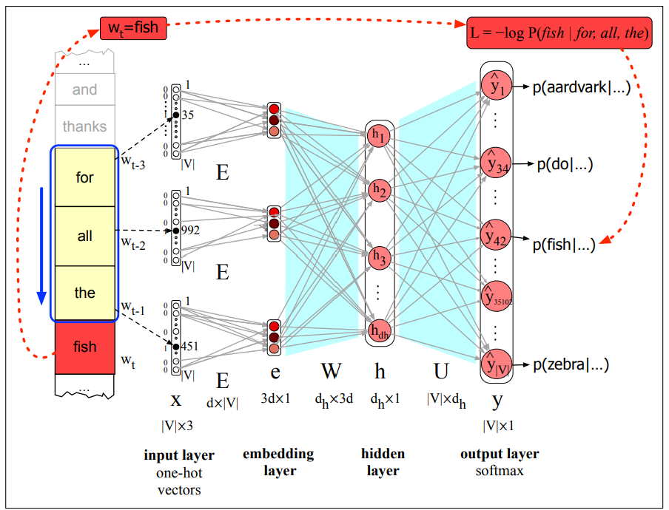
Feedforward layer
What is a Feedforward Network?
Fully connected submodule used in Transformer blocks.
Consists of:
Input Linear Layer: Expands embeddings to higher dimensions.
Activation Function (e.g., GELU, ReLU, SwiGLU, etc.): Applies a non-linear transformation.
Output Linear Layer: Compresses embeddings back to original size.
Purpose: Enhances the model's ability to learn richer representations while maintaining input-output dimension consistency.
Common GPT Example: Embedding size expands from 768 → 3072 → 768.

Slide 21
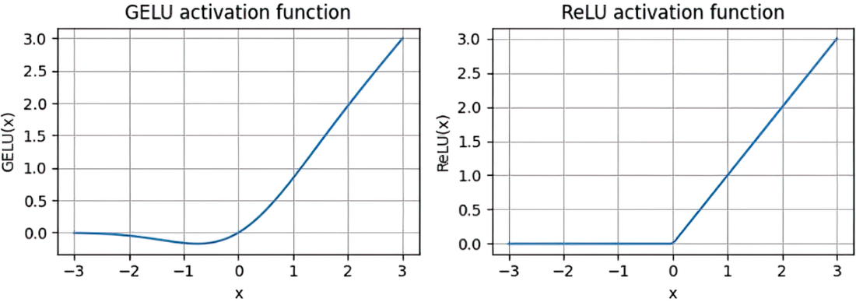
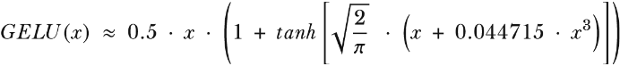
Feedforward layer
GELU vs. ReLU
ReLU:
Outputs max(0,x), ignoring all negative values.
Simple but can result in "dead neurons" (inactive units).
GELU:
Smooth function
Allows small, non-zero contributions from negative inputs.
Enables smoother gradient flow, improving optimization in deep models.

Slide 22
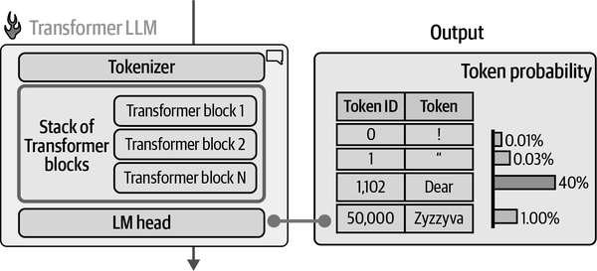
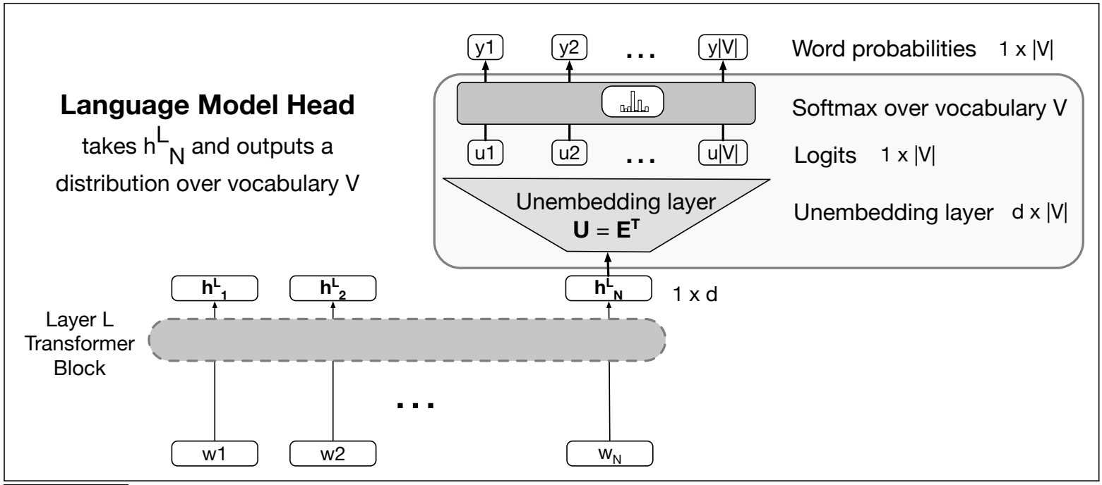
Architecture and Workflow of a GPT Model
Preprocessing The Text
Transformer Blocks
Language Model Head
Raw Text Input
Word Embeddings
Contextual Embeddings
Predicted Text
Lm Head overview:

Slide 23
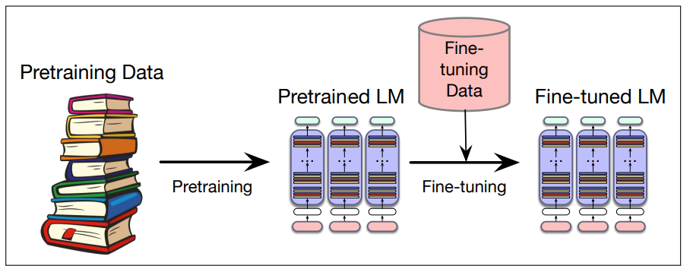
METHODS TO IMPROVE LLM TASK
Prompt Engineering
Guides model behavior without modifying its weights.
Fine-Tuning
Adjusts model weights using domain-specific data
Reinforcement Learning (RLHF - Reinforcement Learning with Human Feedback)
Trains the model using reward signals from human feedback.
Helps align responses with human preferences and reduces harmful outcomes outputs.
Hyperparameter Tuning
Optimizes model settings like learning rate and batch size.
Retrieval-Augmented Generation (RAG)
Enhances responses by retrieving external knowledge before generation.

Slide 24
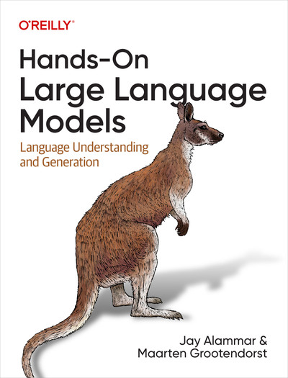
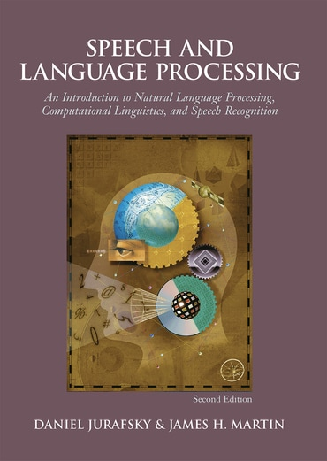

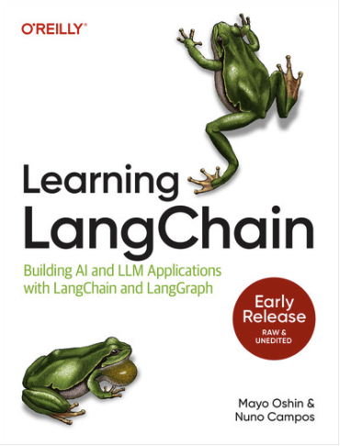
Sources
Alammar, Jay, and Maarten Grootendorst. Hands-on Large Language Models. “O’Reilly Media, Inc.,” 11 Sept. 2024.
Jurafsky, Dan, et al. Speech and Language Processing: An Introduction to Natural Language Processing, Computational Linguistics, and Speech Recognition. Delhi, Pearson Education, 2008.
Mayo Oshin, and Nuno Campos. Learning LangChain. O’Reilly Media, 30 Apr. 2025.
Raschka, Sebastian. Build a Large Language Model (from Scratch). Manning, 27 Aug. 2024.

Slide 25


WHO ARE WE?
Jaylin Dyson, MSDS Student Researcher
Cameron Pykiet, MSDS Student Researcher
Linkedin
Linkedin

Slide 26
Acknowledgements
We would like to acknowledge NSF HBCU-EiR 2302637 for funding our research.
We would also like to thank South Dakota State University for organizing this event and giving us this opportunity.
Thanks!
Any Questions?

